Slide 1


Generating Images Using a Deep Convolutional GAN
Supervisor: Dr. Serhiy Yanchuk
Speaker: Kai Deng
27/09/2024

Slide 2

01
Introduction
02
Historical Models
Overview
03
Theoretical Background
04
Results
05
Discussion

Slide 3
1 Introduction

Slide 4


Introduction
1
Generative Adversarial Network (GAN)
Challenges
Objectives
What

Slide 5
2 Historical
Models

Slide 6
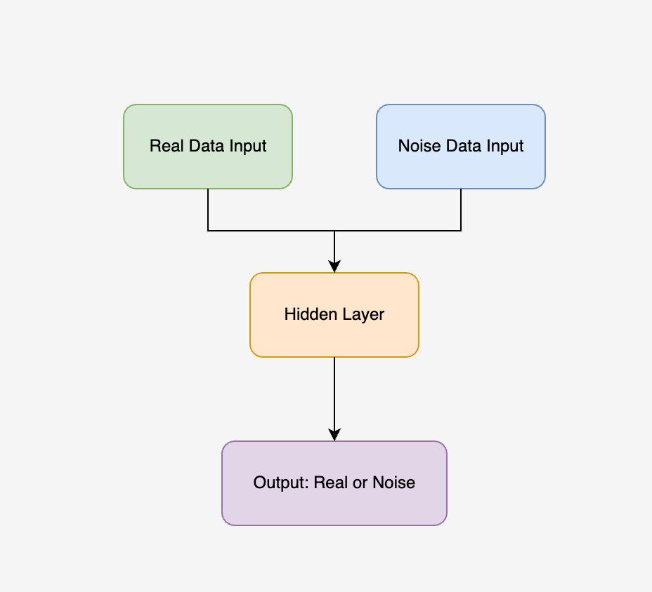
2
Noise Contrastive Estimation
Architecture
What is the NCE?
NCE is a statistical method that simplifies learning by contrasting real data with noise.
Applications:
• Density estimation and language modelling.
• Laying the groundwork for image generation.

Slide 7
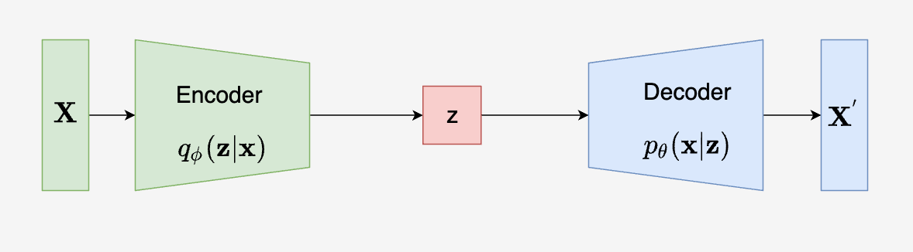
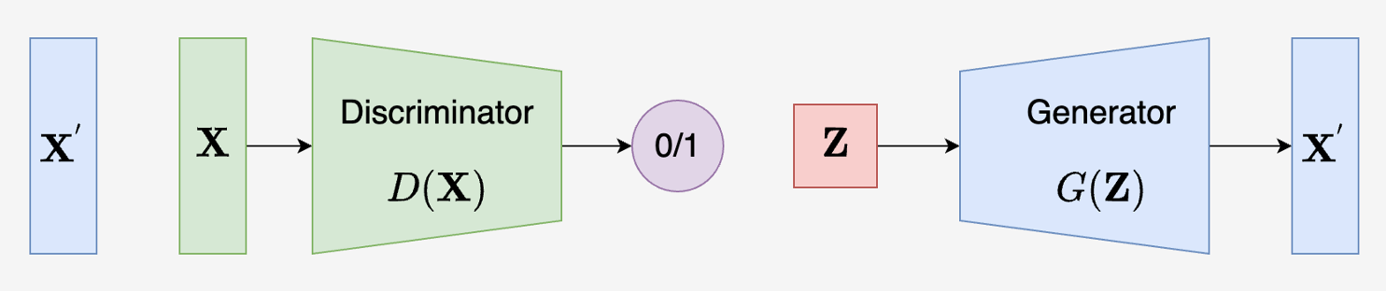
3
Variational Autoencoder
What is the VAE?
VAE is a generative model that encodes input data into a latent space and reconstructs it by minimizing the reconstruction loss.
Architecture:
Applications:
Image generation, data compression, and outlier detection.

Slide 8
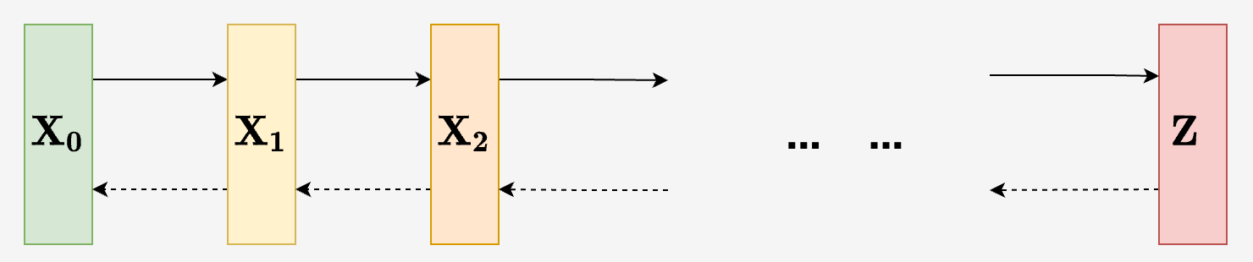
Diffusion Model
4
What is the Diffusion Model?
Progressively add noise to the data and learn to reverse this process to generate high-quality outputs.
Architecture:
Applications:
Image generation and audio synthesis.

Slide 9
3 Theoretical Background

Slide 10
5
Objective Function of GAN
What Is Objective Function:
It like a minimax game between the generator and the discriminator.
Formula:
Generator’s Goal:
Minimize the probability the discriminator correctly identifies fake data.
Discriminator’s Goal:
Maximize the probability of correctly distinguishing real from fake data.

Slide 11
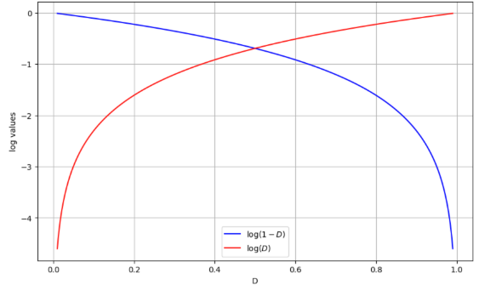
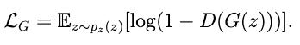
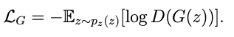
6
Loss Function of GAN
Discriminator’s Loss:
Measures how well the discriminator classifies real and fake data.
Loss function:
Generator’s Loss:
Measures how well the generator fools the discriminator.
Loss function:
x
Figure : Diagram for log(1-D) and log D

Slide 12
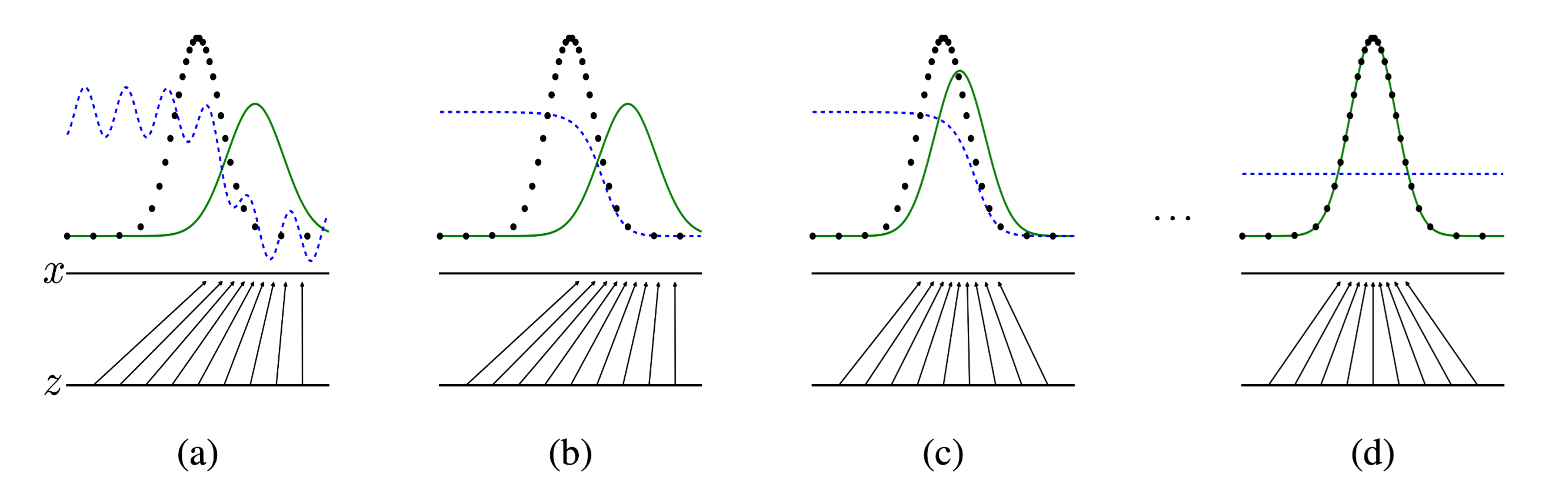
7
Training Process of GAN
Figure: Distribution Change during GAN Training
Source: I. J. Goodfellow, "Generative adversarial nets," 2014.
Green curve: generated data distribution. Black dots: real data distribution (constant). Blue line: the output of the discriminator.

Slide 13
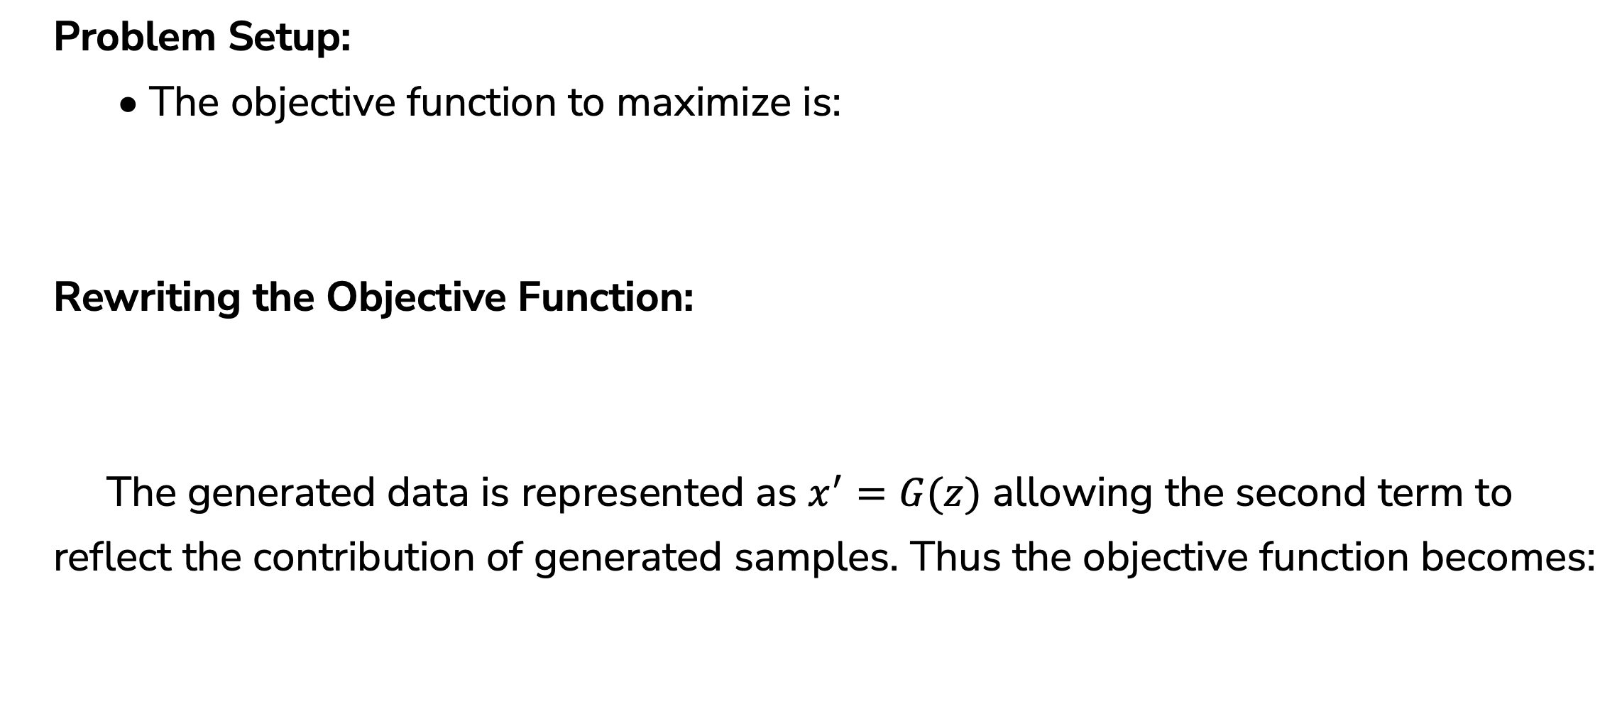
8
Training Process of GAN
Problem Setup:
• The objective function to maximize is:
Rewriting the Objective Function:
The generated data is represented as $x^{′}=G(z)$ allowing the second term to reflect the contribution of generated samples. Thus the objective function becomes:

Slide 14
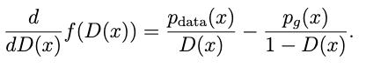
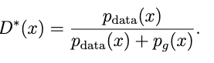
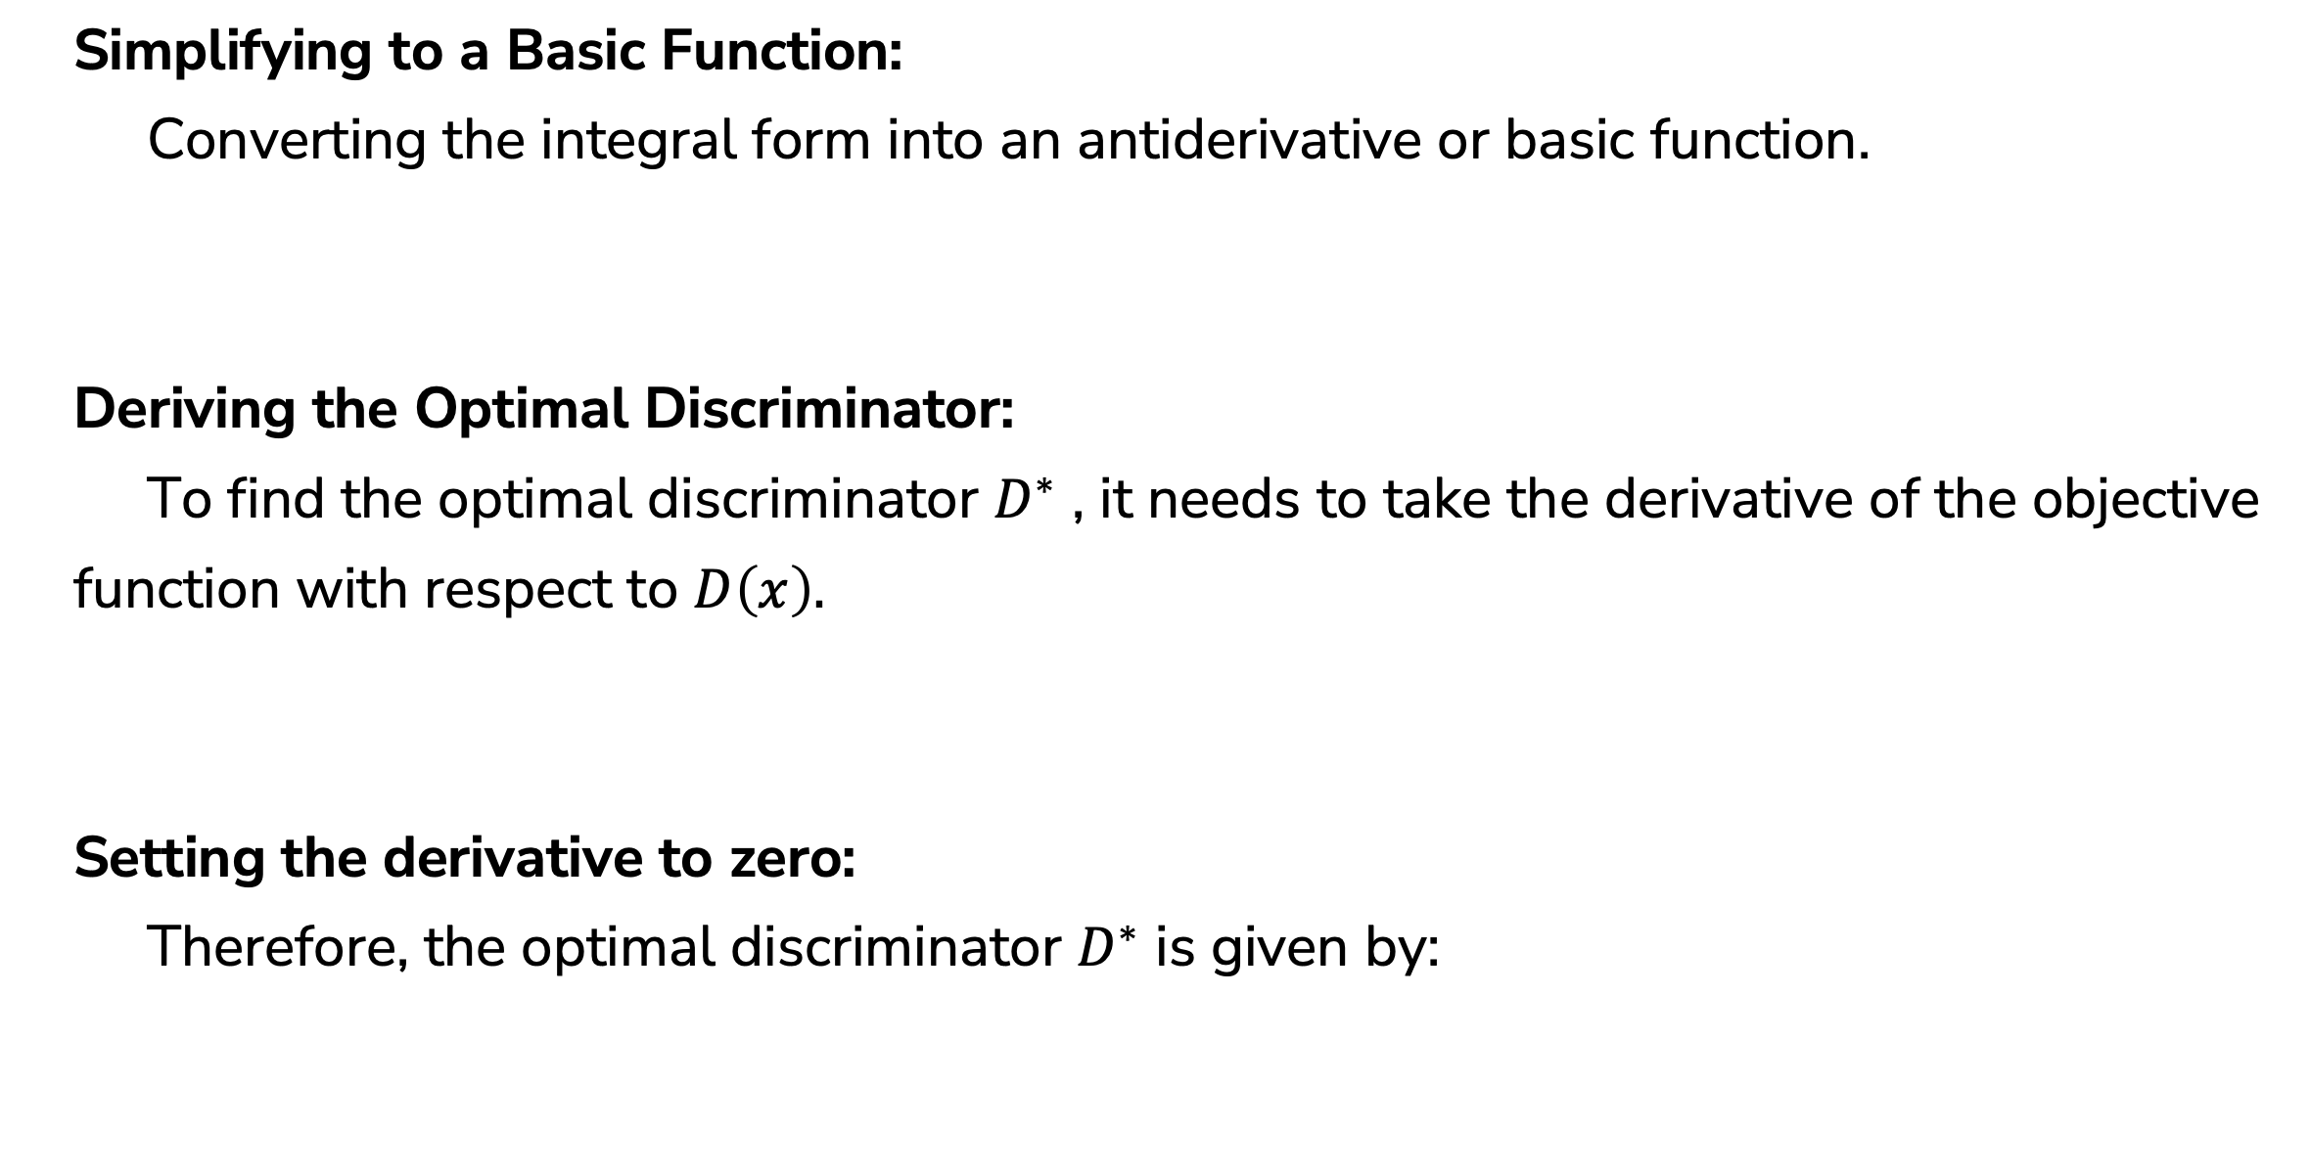
9
Training Process of GAN
Simplifying to a Basic Function:
Converting the integral form into an antiderivative or basic function.
Deriving the Optimal Discriminator:
To find the optimal discriminator $D^{∗}$ , it needs to take the derivative of the objective function with respect to $D\left(x\right).$
Setting the derivative to zero:
Therefore, the optimal discriminator $D^{∗}$ is given by:

Slide 15
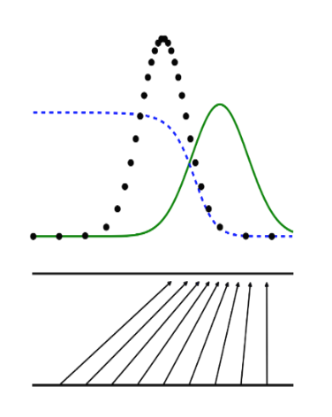
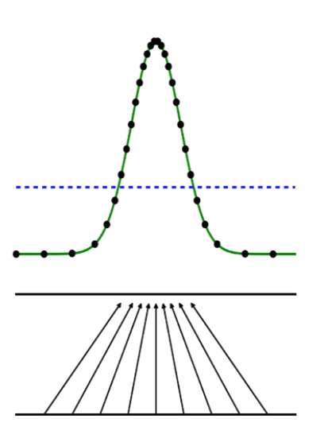
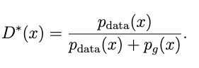
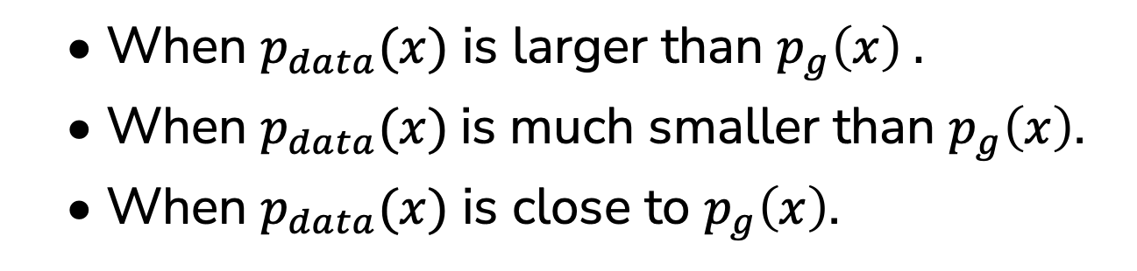
Verifying the Optimal Discriminator
10
• When $p_{data}(x)$ is larger than $p_{g}\left(x\right) .$
• When $p_{data}(x)$is much smaller than $p_{g}\left(x\right)$.
• When $p_{data}(x)$ is close to $p_{g}\left(x\right)$.
x

Slide 16
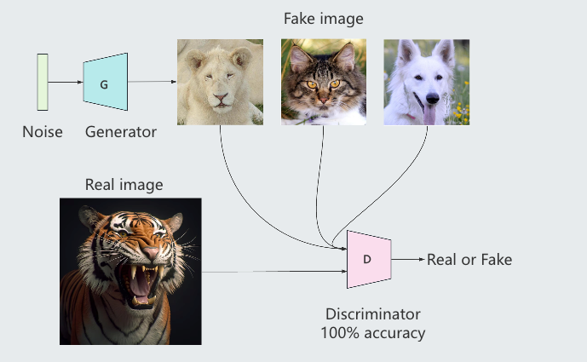
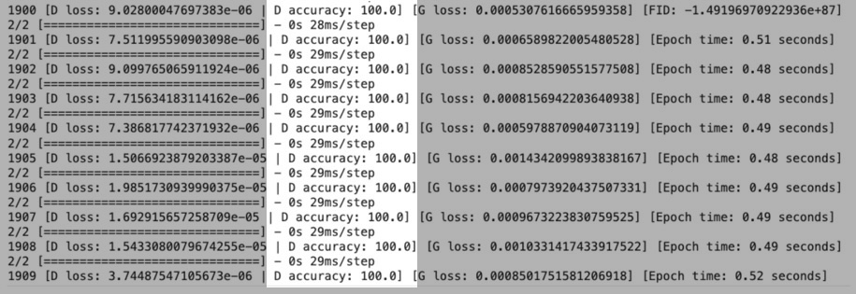
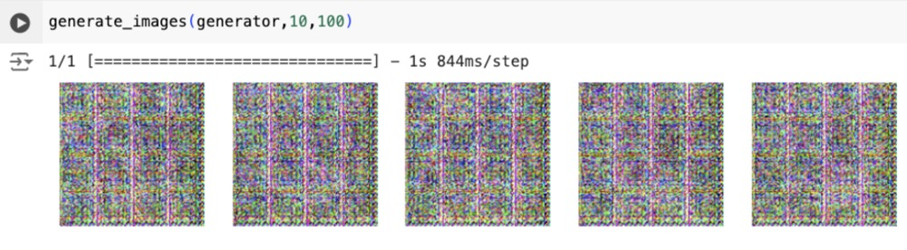
11
Evaluating GAN Performance
A GAN model with 100% accuracy means the balance between the generator and the discriminator is broken.
x

Slide 17
4 Results

Slide 18
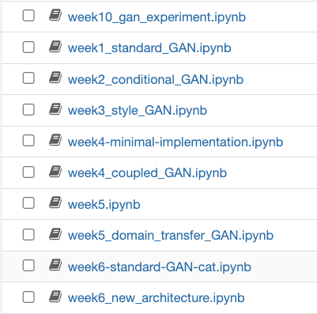
12
Model Select
Reason for Choosing Standard GAN:
• Foundational Model: Standard GAN serves as the base for all other GAN variants.
• Well-documented: Extensive literature available for comparison and reference.
• Training Efficiency: More computationally feasible to implement within hardware constraints.
• Flexibility: Can be adapted to various image generation tasks, providing a solid baseline for comparison with more complex models.
x

Slide 19
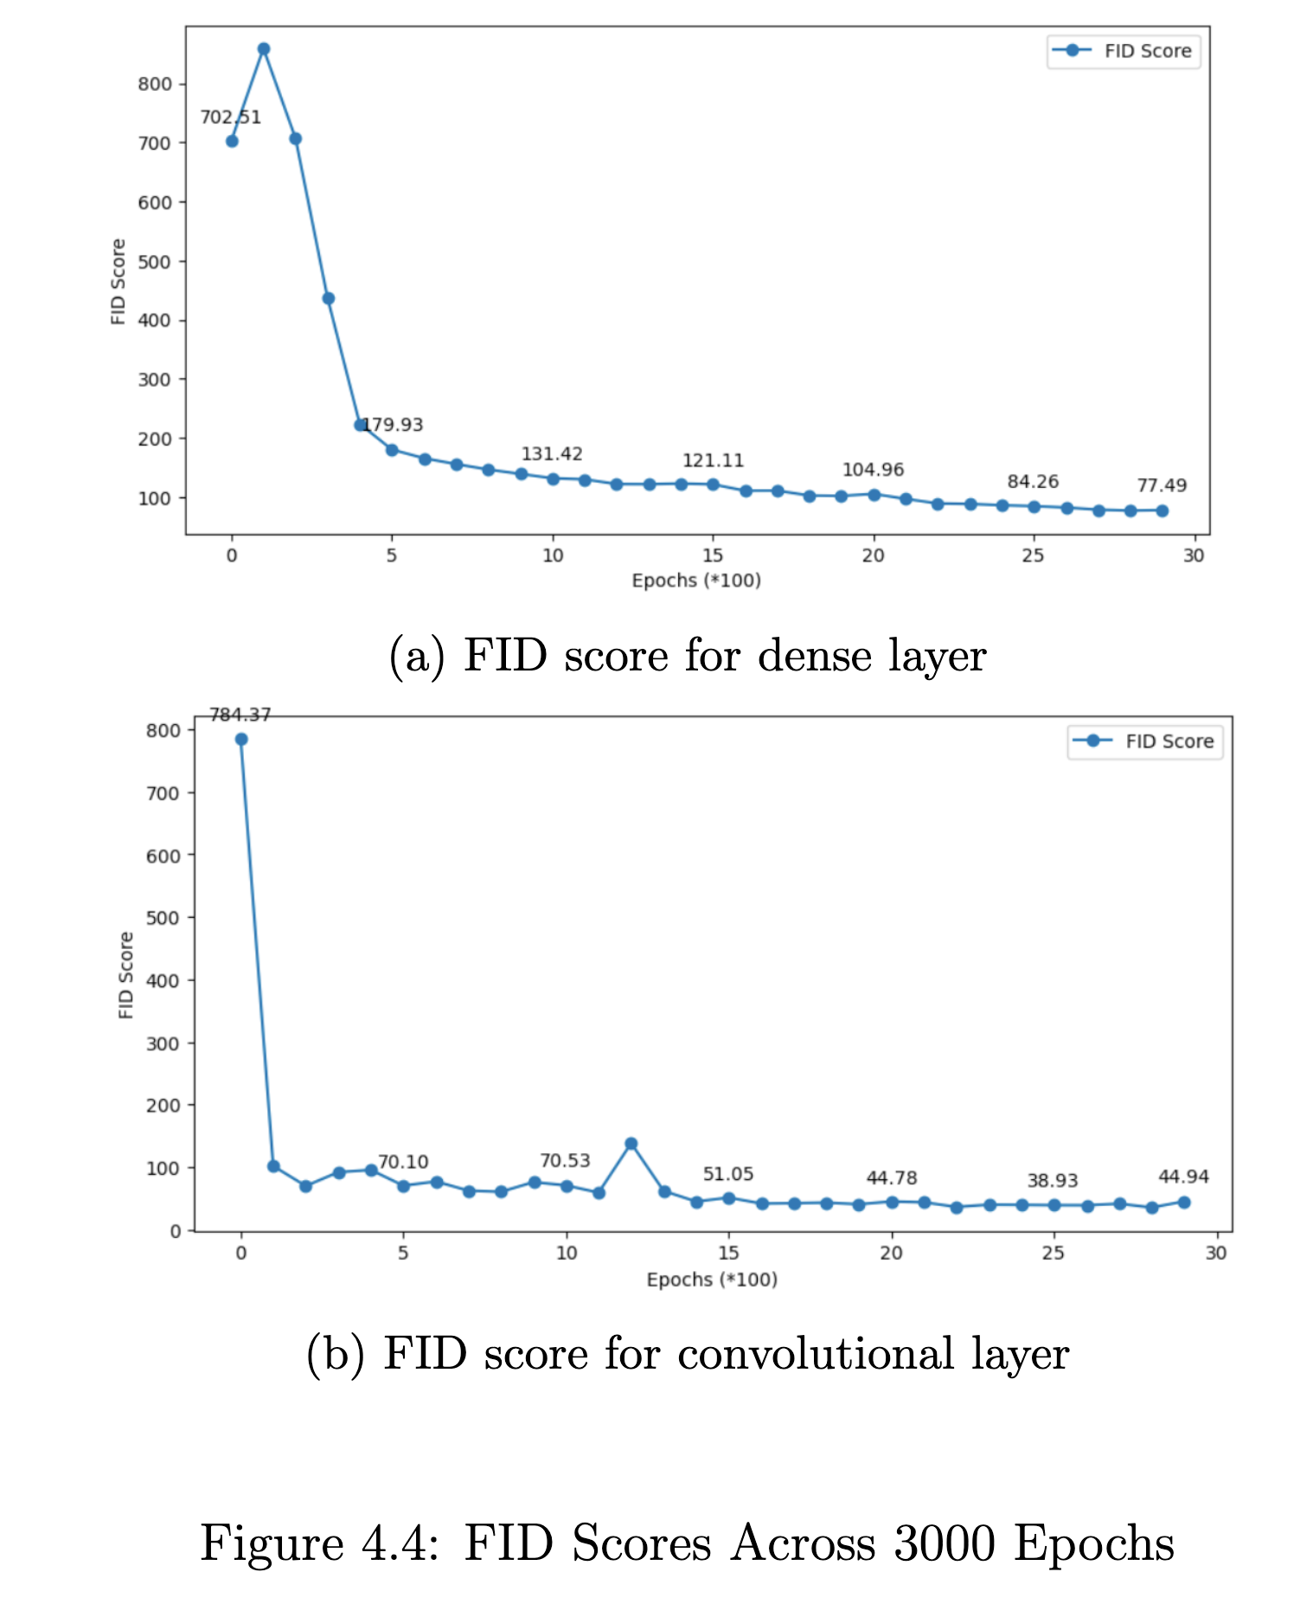
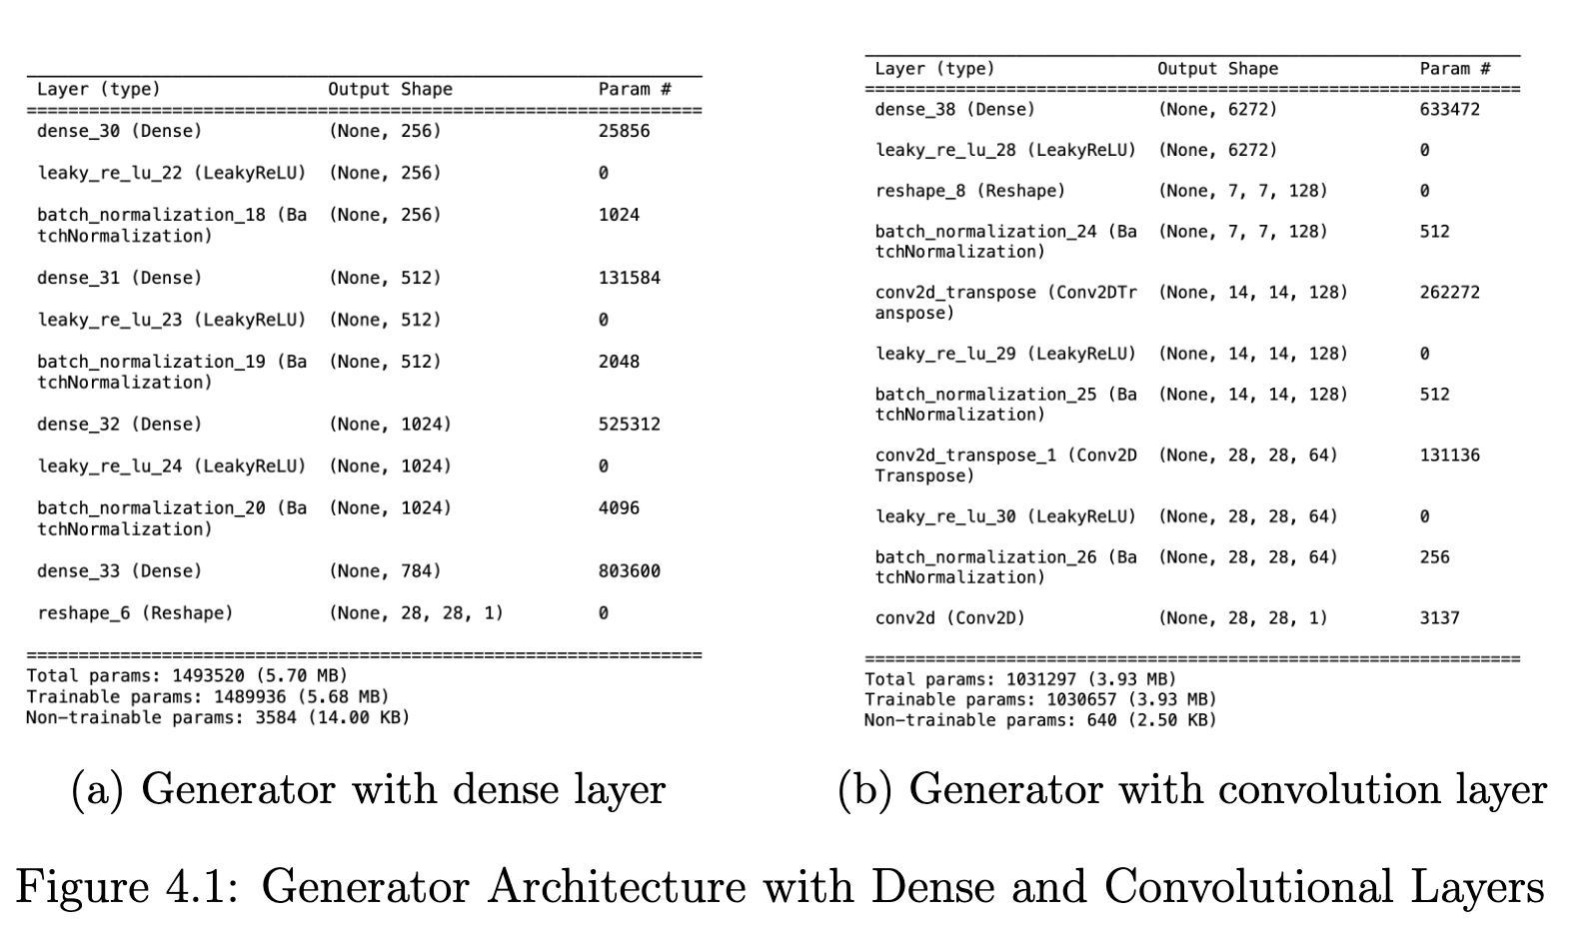
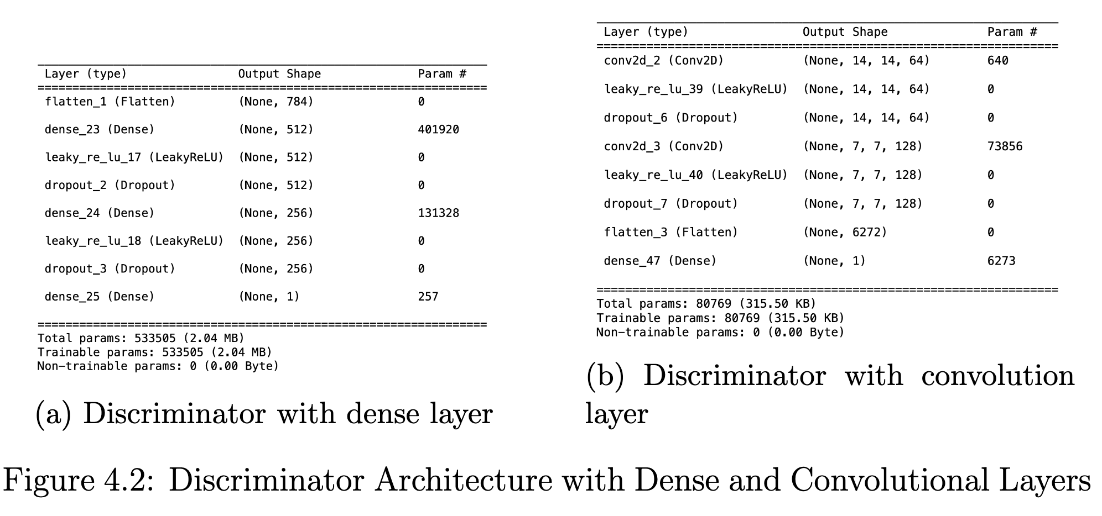
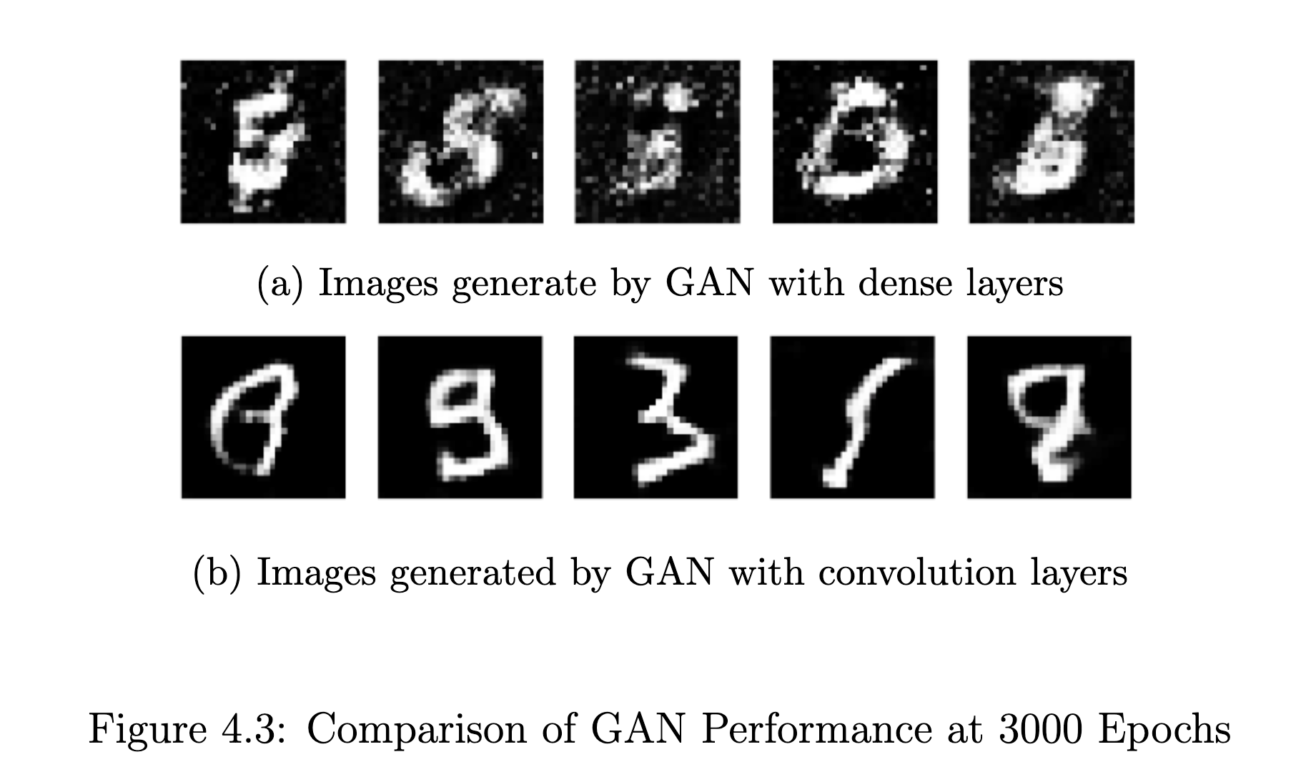
13
Convolutional or Dense
Objective:
Compare the GAN model with Convolutional Layers and Dense Layers.
Key Factors Tested:
• Image quality.
• FID score.
Dataset:
MNIST Dataset
x

Slide 20
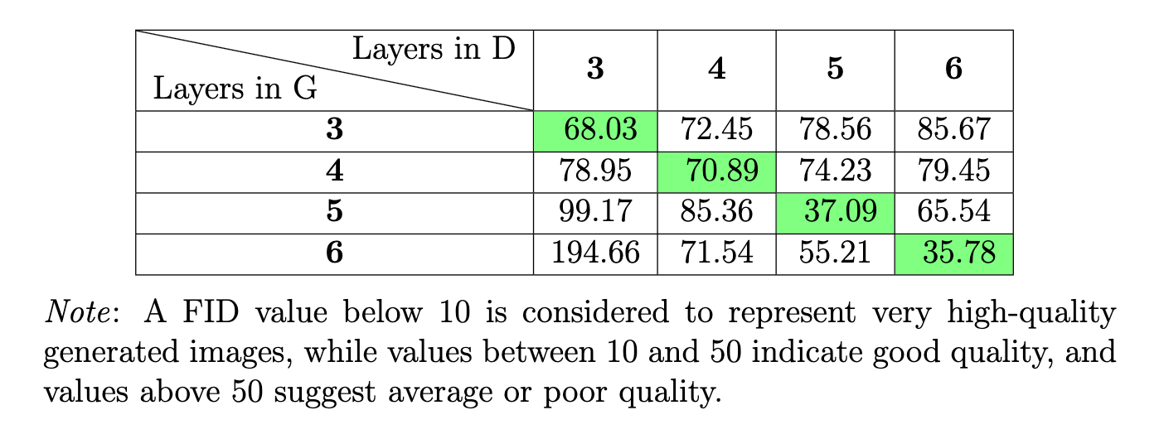
14
Exploring Layer Depth
Objective:
• Impact of increasing layer depth.
Experiment Setup:
• Base Model: 3 layers standard GAN.
• Layer Variations: Add 4, 5, and 6 layers in both generator and discriminator.
• Key Metric: FID score.
Results:
• Increasing depth in only the generator or discriminator leads to worse performance.
• Increasing depth in both networks simultaneously results in better performance.

Slide 21
15
Impact of Data Augmentation
Objective:
• Impact of data augmentation.
Techniques Tested:
• Rotation: Rotating images by a 10 degree.
• Shifting: Vertical and horizontal shift 0.1.
• Flipping: horizontal flips.
Results:
Without Data Augmentation model performs best.
After Adjustments:
• Removing certain techniques (e.g., flipping, rotation).

Slide 22
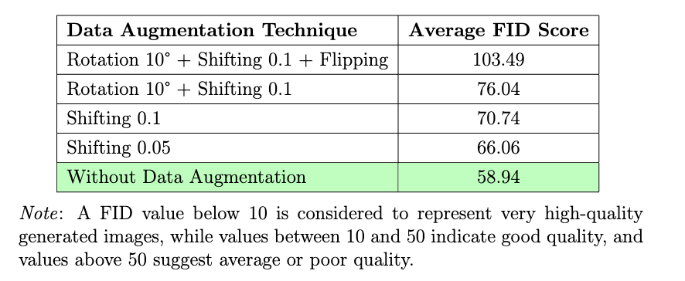
16
Impact of Data Augmentation
Results
Assumption:
Data augmentation introduced noise, disturbing the real data distribution.

Slide 23
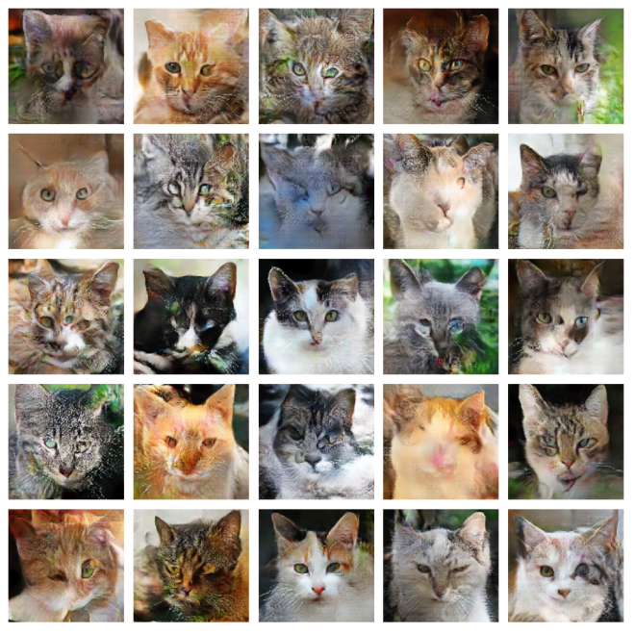
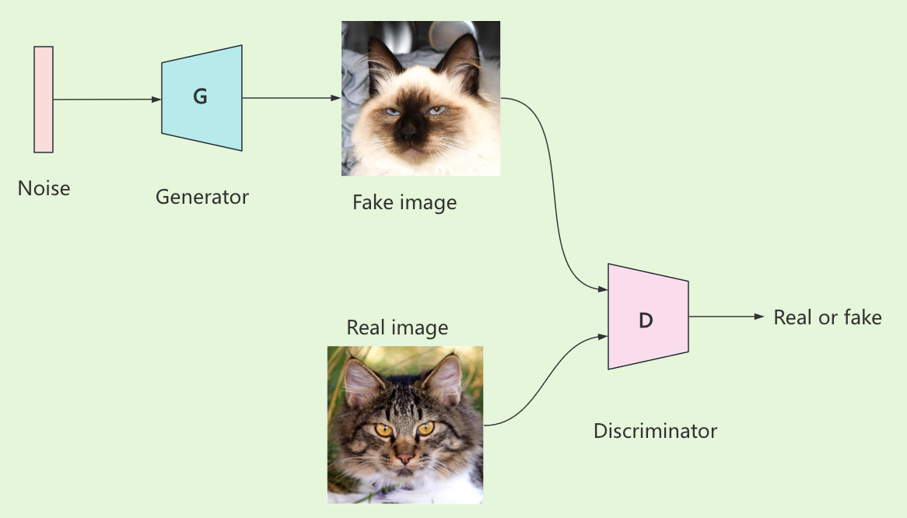
Applying Animal Faces HQ Dataset
17
Dataset Overview:
• 16,130 high-quality images of animal faces.
• 512x512 pixels.
Model Structure:
• Generator: 5 transpose convolutional layers with LeakyReLU activation .
• Discriminator: 5 convolutional layers with LeakyReLU activation.
Training Details:
• Optimizer: Adam.
• Learning rate: 0.002.
• Epochs: 4000.

Slide 24
5 Discussion

Slide 25


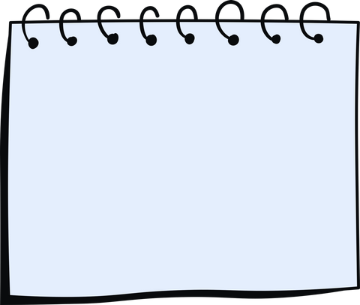
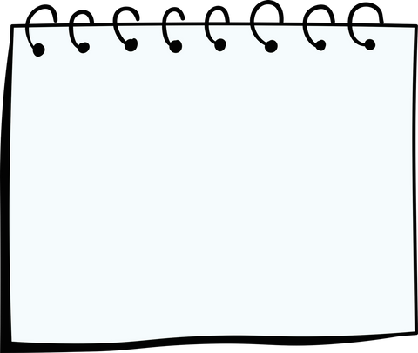

Summary and Future Work
18
1
2
3
4
Summary 1
Summary 2
Summary 3
Summary 4
GAN with dense layers or convolutional layers.
Exploring layer depth.
Impact of data augmentation
Applying the GAN model with the Animal Faces-HQ dataset.

Slide 26


University College Cork
Thank You

Slide 27
Future Work
19
Model Improvements:
• Adjust hyperparameters for better stability.
• Explore advanced architectures like StyleGAN.
• Dataset:
• Use larger and more diverse datasets for improved generalization.
• New Techniques:
• Experiment with adaptive data augmentation methods.

Slide 28

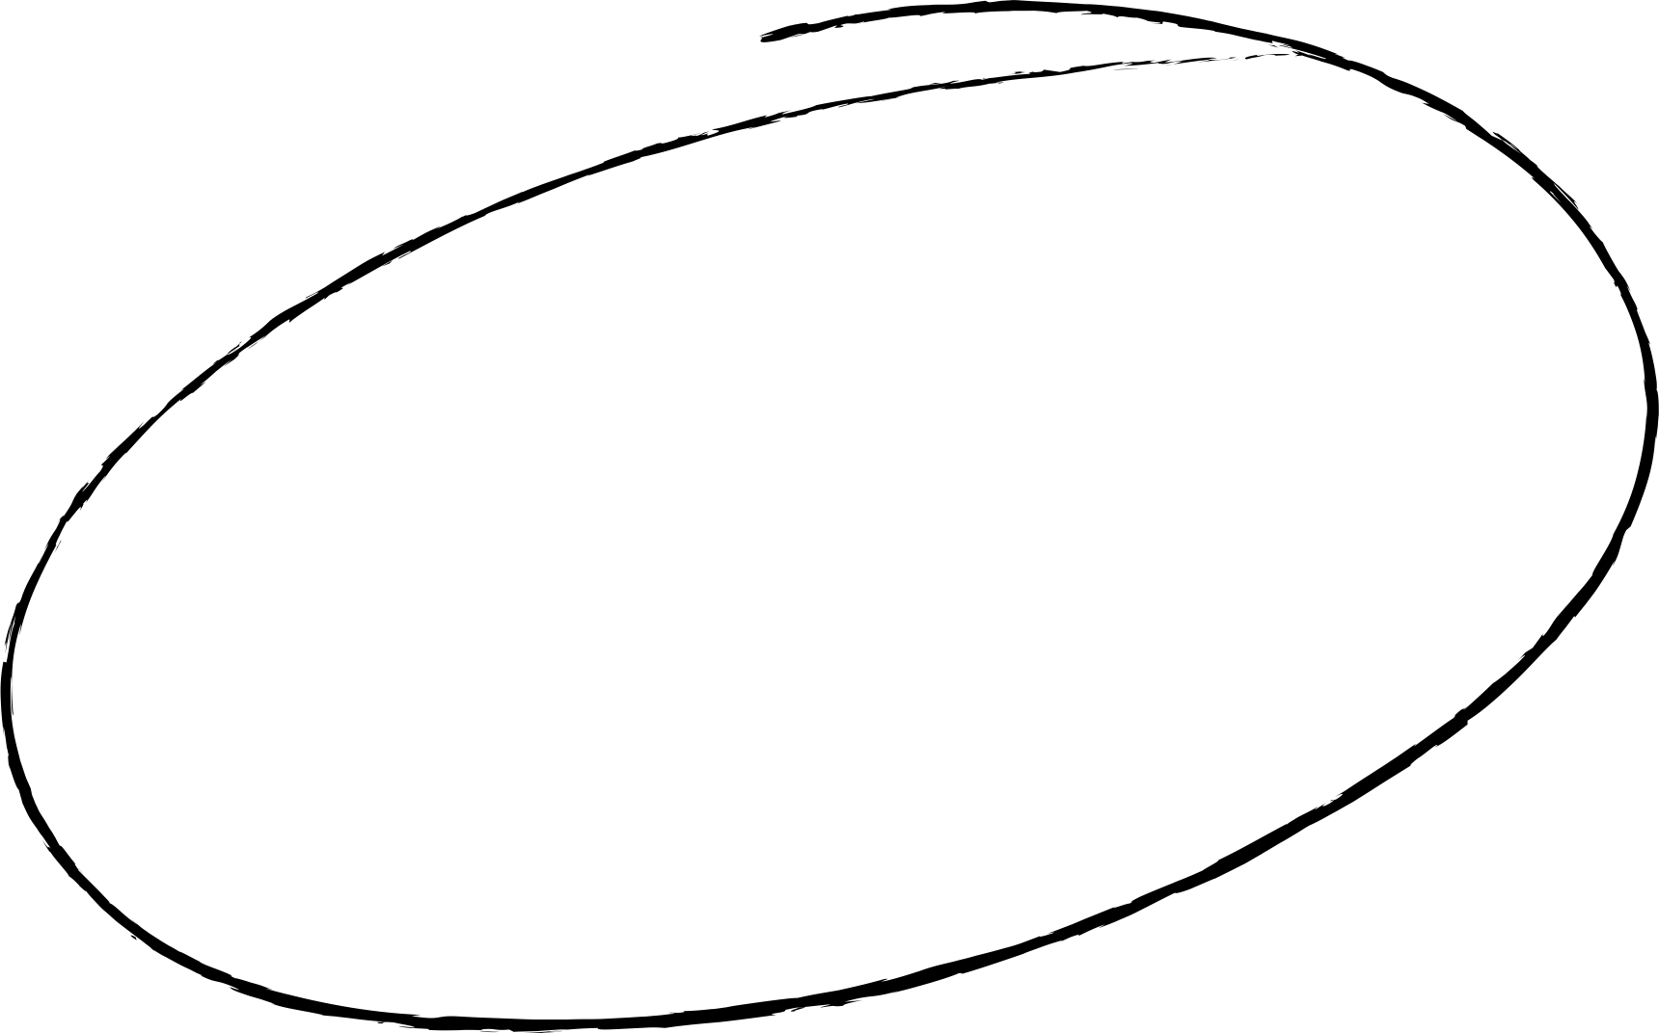
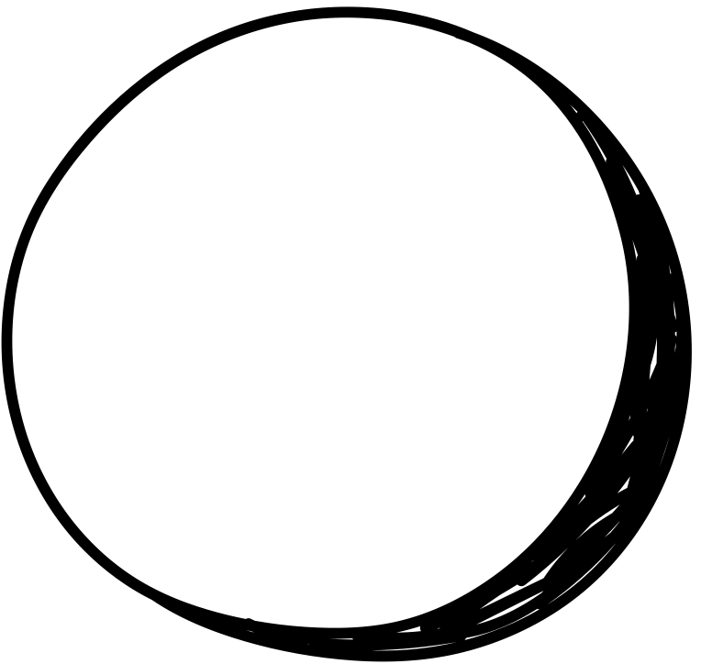
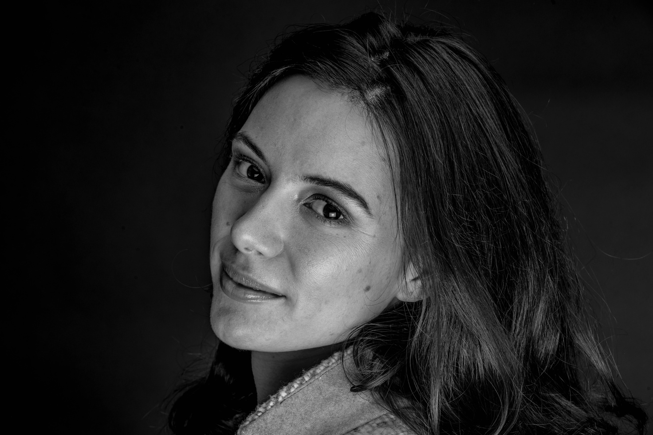

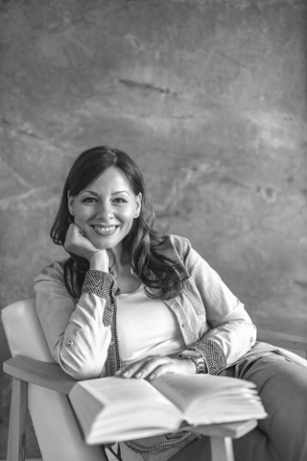

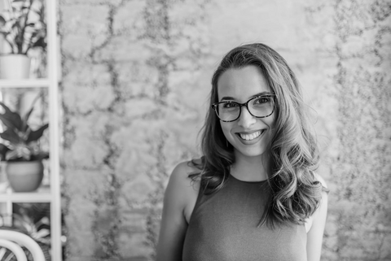

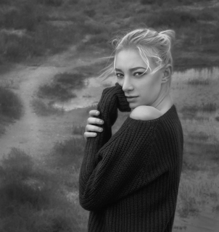
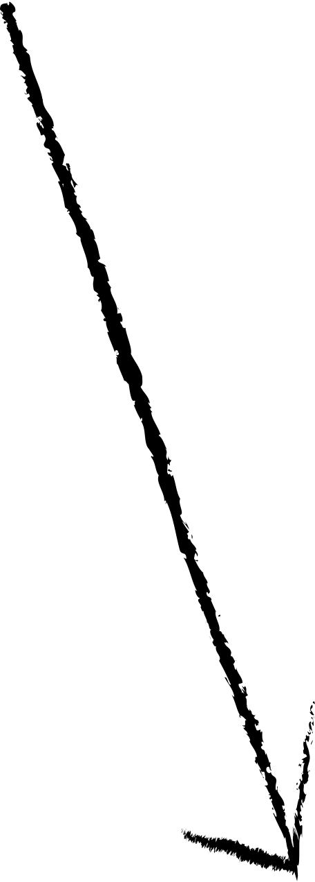
Summary
Action 1
Action 3
1
Write action items
in the boxes.
Copy a sticky note, then write your thoughts
Copy a sticky note, then write your thoughts
Copy a sticky note, then write your thoughts
Action 2
Action 4
2
Drag your photo under the action item you want to own.
Copy a sticky note, then write your thoughts

Slide 29
Discussion
18
Model Performance:
• The generator demonstrated a capacity to produce relatively high-quality images.
• The discriminator showed effectiveness in distinguishing between real and generated data.
Challenges:
• Data Augmentation: Introduced noise, slightly affecting performance.
• Training Stability: Occasional instability due to adversarial training dynamics.
Evaluation:
FID Scores: Without data augmentation, the model performed more consistently.

Slide 30
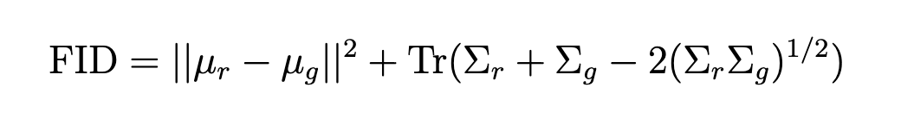
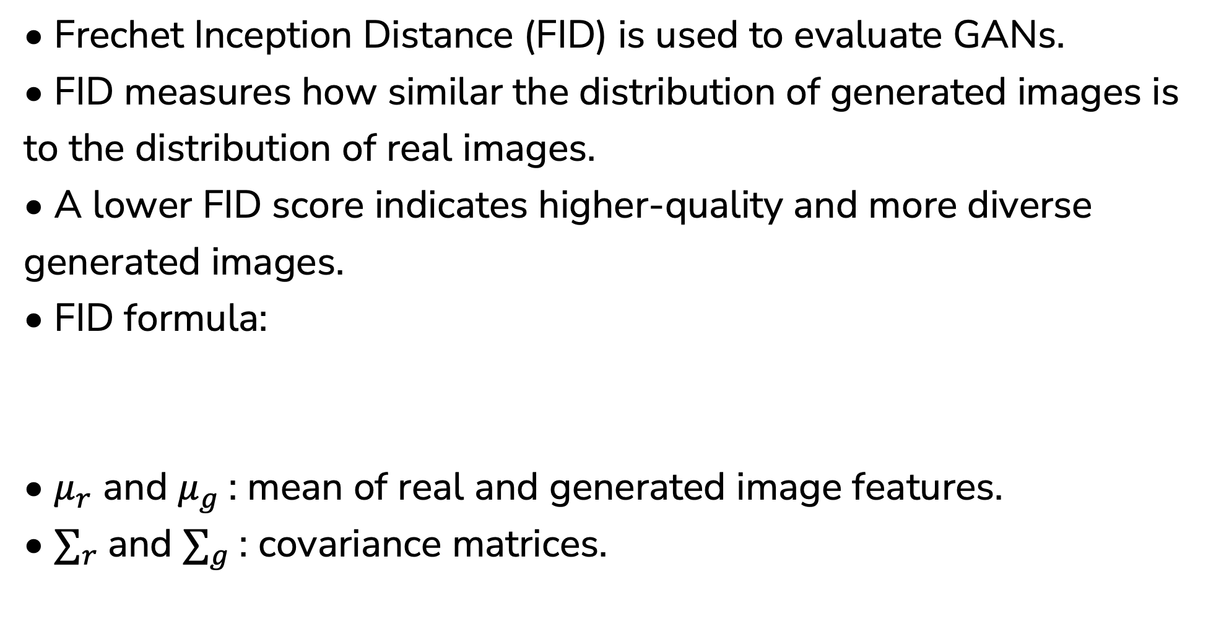
20
Frechet Inception Distance
• Frechet Inception Distance (FID) is used to evaluate GANs.
• FID measures how similar the distribution of generated images is to the distribution of real images.
• A lower FID score indicates higher-quality and more diverse generated images.
• FID formula:
• $μ_{r}$ and $μ_{g}$: mean of real and generated image features.
• $∑_{r}$and $∑_{g}$: covariance matrices.

Slide 31
Generative Adversarial Network
05
What is GAN?
GAN consists two networks a generator and a discriminator that compete to improve data generation quality.
Architecture:
Applications:
Image generation, video synthesis, and style transfer.

Slide 32
Introduction
01
What is GAN?
Generative Adversarial Network (GAN) was introduced by Goodfellow in 2014.
Why GAN for Image Generation?
• Generating high-quality and realistic images.
Challenges with GAN
Mode collapse, vanishing gradients, and instability.
The objective of the Thesis
• GAN with dense layers or convolutional layers.
• Exploring layer depth.
• Impact of data augmentation.
• Applying the GAN model with the Animal Faces-HQ dataset.

Slide 33
Future Work
23
$$\min_{G} \max_{D} V\left(D, G\right)=E_{x \sim p_{data}(x)}\left[\log{D\left(x\right)}\right]+E_{z \sim p_{z}(z)}\left[log (1 −{D\left(G(z)\right))}\right]$$
Model Improvements:
• Adjust hyperparameters for better stability.
• Explore advanced architectures like StyleGAN.
• Dataset:
• Use larger and more diverse datasets for improved generalization.
• New Techniques:
• Experiment with adaptive data augmentation methods.

